Slide 1
Physiolibrary 2.1
www.physiolibrary.org

Slide 2
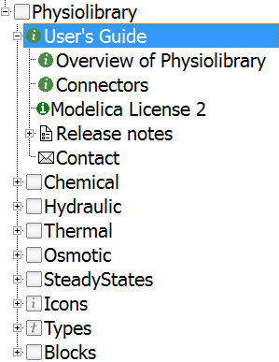
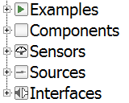

Physiolibrary Structure

Slide 3
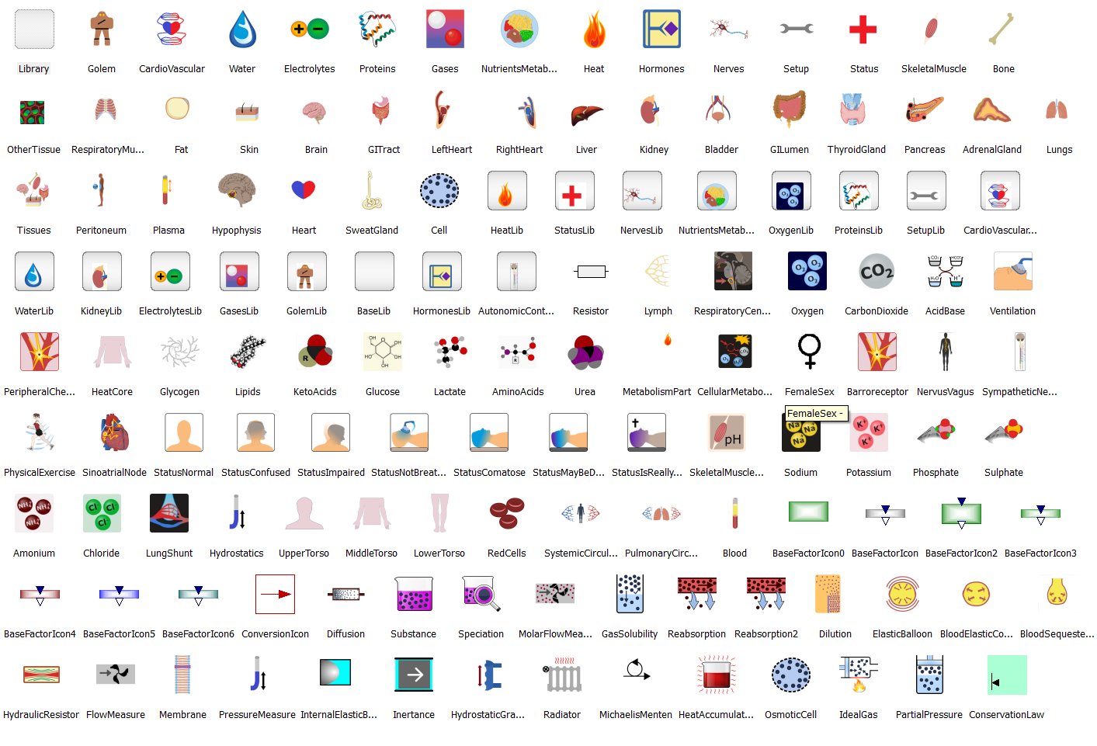
Icons

Slide 4
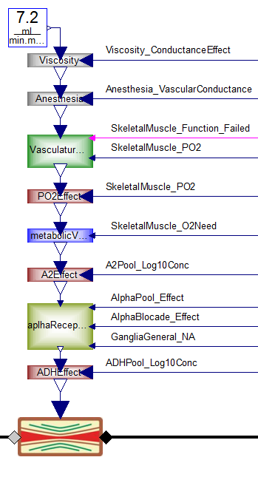
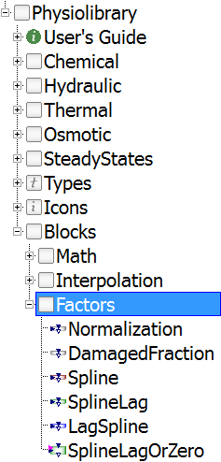
Blocks.Factors

Slide 5
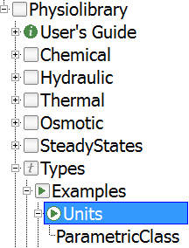
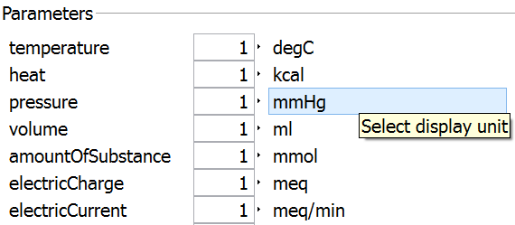
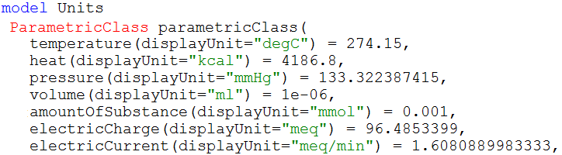
Types

Slide 6
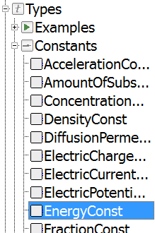
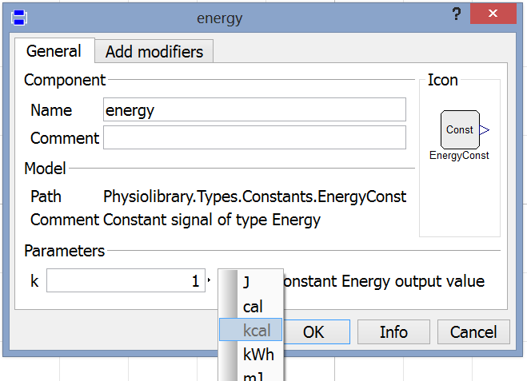
Types.Constants

Slide 7
reciprocal physical quantities
Selected Quantity .. Q | Reciprocal Quantity .. 1/Q
Hydraulic conductance | Hydraulic resistance
Hydraulic compliance | Hydraulic elastance
Gas solubility | Gas volatility
Electric resistance | Electric conductance
… | …
Users are accustomed to use any physical quantity.
May be the reciprocal quantities should be supported by Modelica Environments (like display units)?

Slide 8
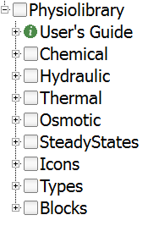

Connectors
ChemicalPort
molar concentration, molar flow
HydraulicPort
pressure, volumetric flow
ThermalPort
temperature, heat flow
OsmoticPort
osmolarity, osmotic volumetric flow

Slide 9
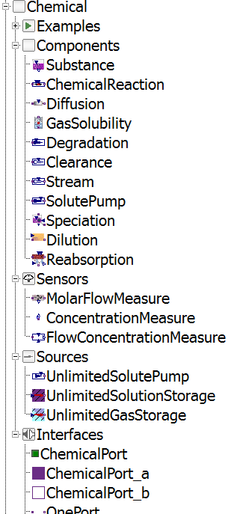
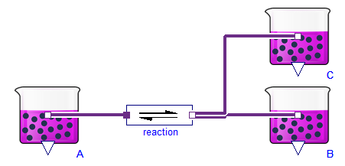
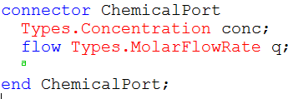
Chemical

Slide 10

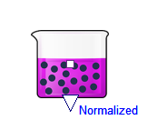

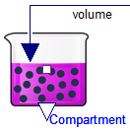
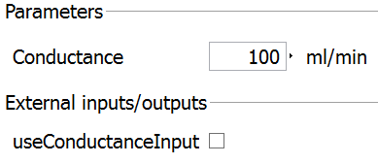
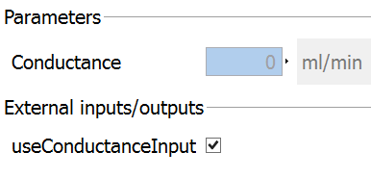


CONDITIONAL INPUTS

Slide 11

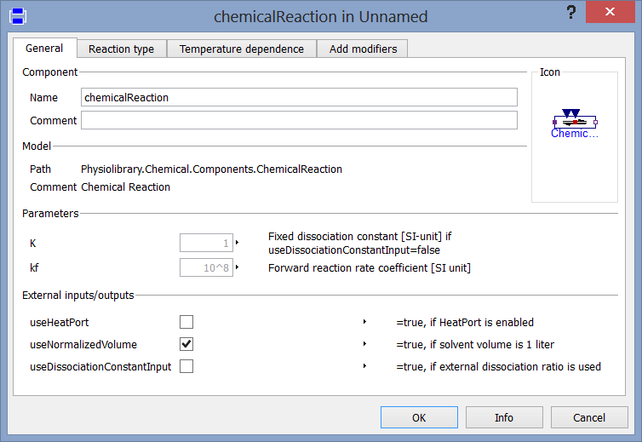
Chemical Reaction

Slide 12
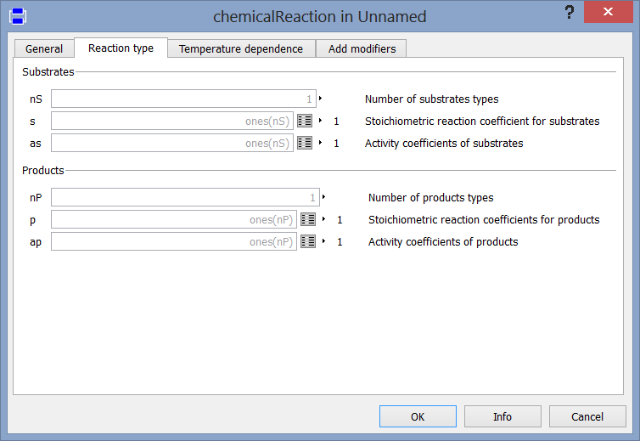
Chemical Reaction

Slide 13
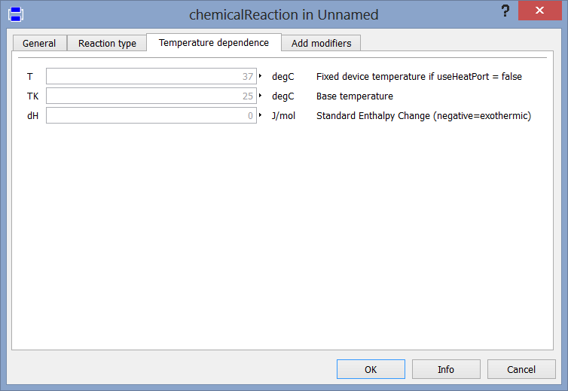
Chemical Reaction

Slide 14
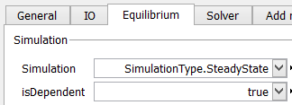
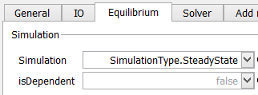
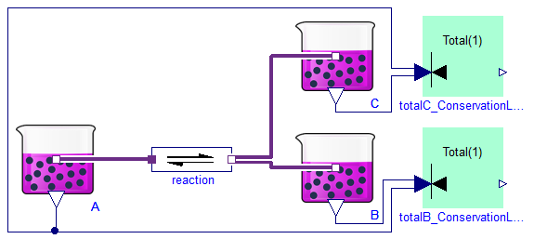

STEADY STATES
Zero derivations (dependent equation set)

Slide 15
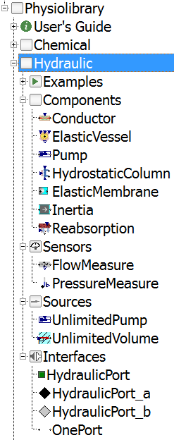
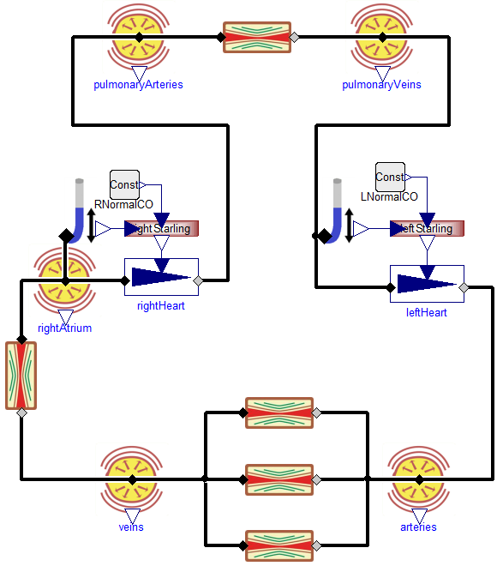
Hydraulic

Slide 16
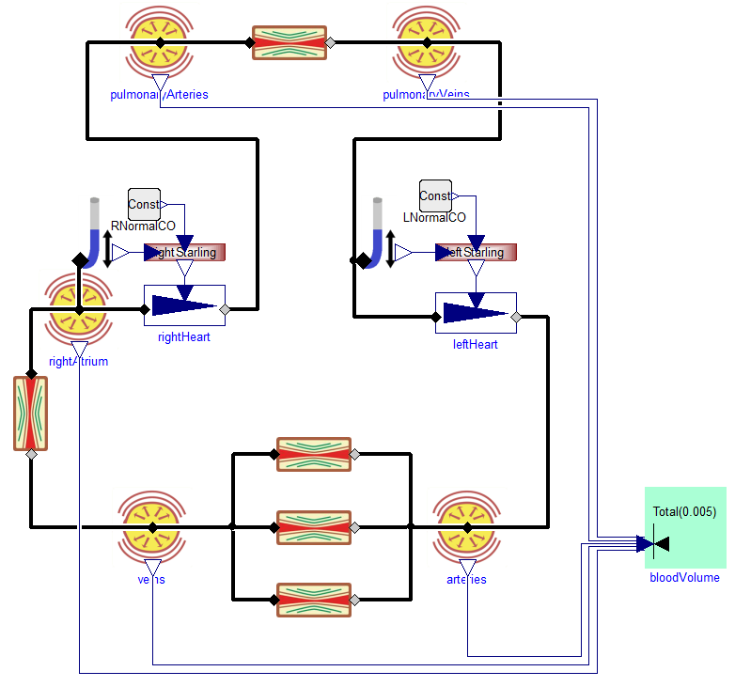
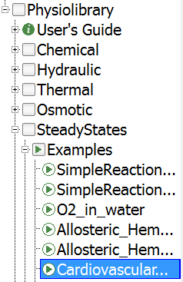

Slide 17
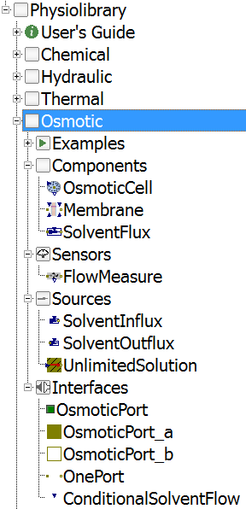
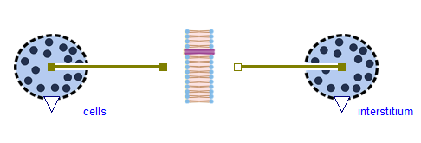
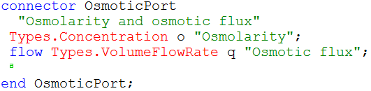
Osmotic

Slide 18
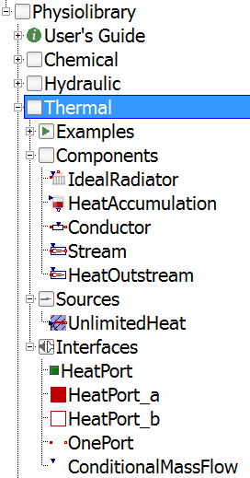
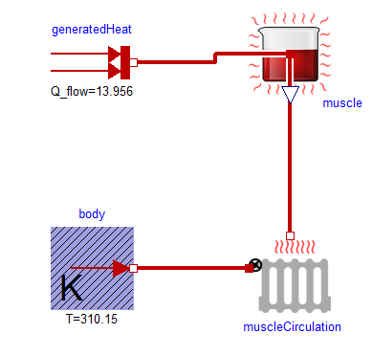
Thermal

Slide 19
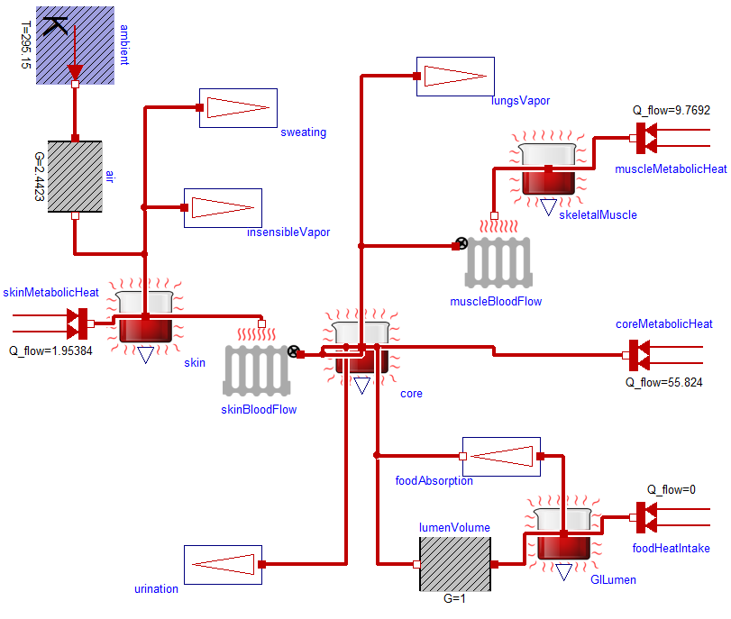

Slide 20
Thank you for your attention!
www.physiolibrary.org

